Slide 1
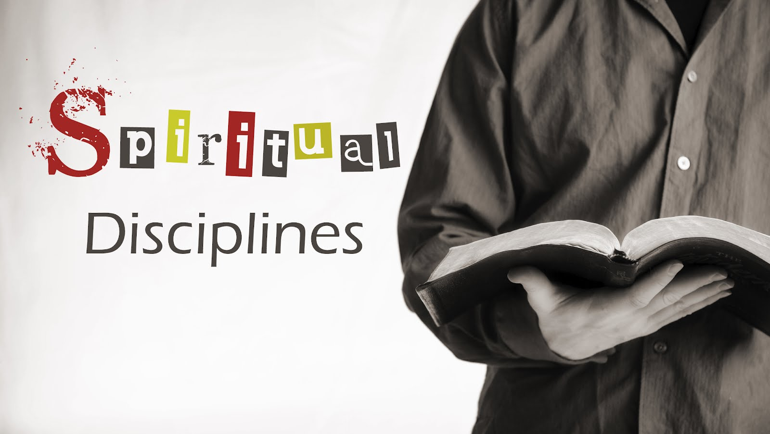

Slide 2
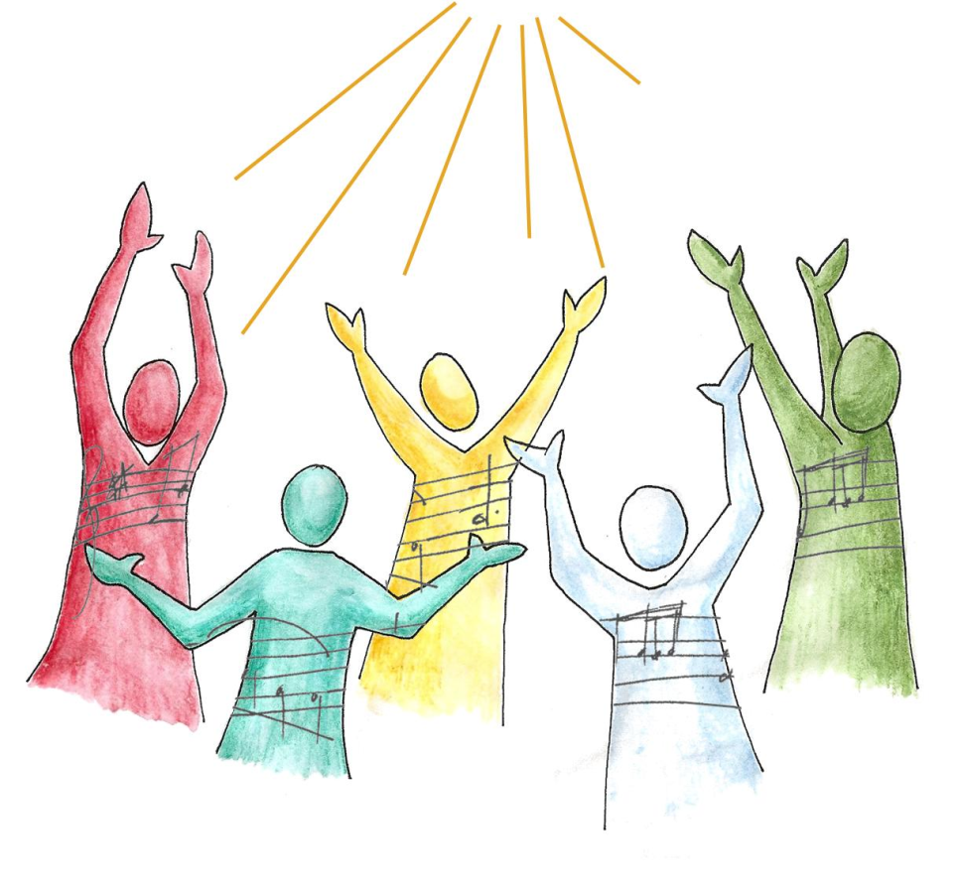
The Corporate disciplines: Part 2
Worship & Celebration

Slide 3
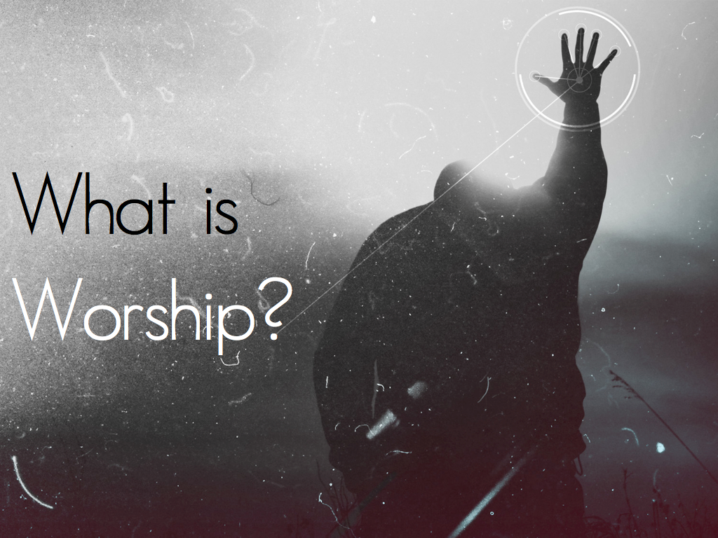

Slide 4

Worship Defined…
Worship comes from the old English word worthship.
To worship God is to ascribe the proper worth to God, to magnify His worthiness of praise and approach and address God as He is worthy.
Worship involves focusing on and responding to God, and the more we focus on God, the more we understand and appreciate how worthy he is.

Slide 5
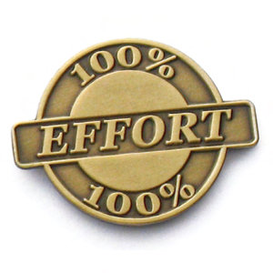
How is worship a discipline?
True worship takes effort, it needs to be nourished and requires focus.
Without discipline our worship becomes thin and inconsistent.
Worship is a discipline because real worship requires the ability to shed distractions and to give our hearts to another.

Slide 6
What is biblical worship?
Biblical worship is worship in spirit and truth (John 4:21-24), worship that comes from the heart and is based on a true view of God.
Biblical worship is offered through the Lord Jesus Christ as the only mediator who stands in the congregation and declares God's name to His people and sings God's praises with His people (Hebrews 2:11-12 and Psalm 22:22-31)
Biblical worship is Christ-centered and gospel-centered as people from every tribe and tongue and language and nation sing praise to the Lamb who was slain (Revelation 5:9-13).

Slide 7
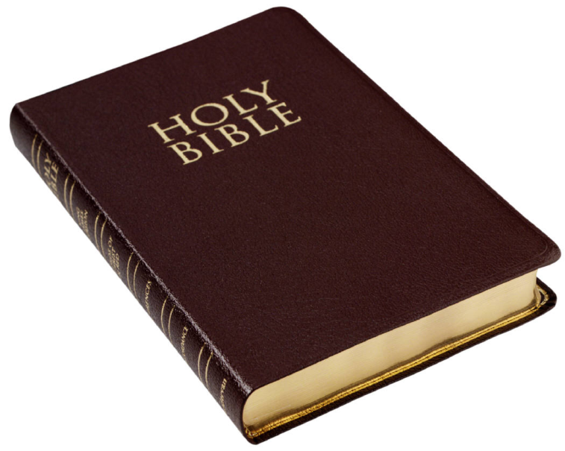
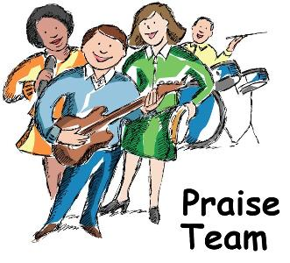
Biblical worship is Word-centered in all of the elements of prayer, reading of Scripture, preaching, confessions of faith, offerings, singing of psalms, hymns, and spiritual songs, and the sacraments.
Biblical worship makes use of the gifts of God's people (I Corinthians 14:26) under the wise oversight and leadership of qualified and trained elders (Hebrews 13:17; I Timothy 3:1-7
Biblical worship extends beyond Sunday mornings into all of life.

Slide 8
What is Reformed worship?
Reformed worship includes the principles just mentioned under biblical worship along with some additional distinctions that reflect our biblical and theological understanding and emphasis.
Reformed worship is consistent with what is known as the "Regulative Principle of Worship” which states that…
“the acceptable way of worshiping the true God is instituted by himself, and so limited by his own revealed will, that he may not be worshiped according to the imaginations and devices of men, or the suggestions of Satan, under any visible representation, or any other way not prescribed in the Holy Scripture.” Westminster Confession of Faith 21-1

Slide 9
This means that Reformed worship includes…
a deep reverence before God that takes our sin seriously.
an overwhelming joy in the presence of our Father who loves, forgives, and adopts us by grace and invites us to be seated as honored guests at His table.
expository Christ-centered preaching that fills the mind with truth and transforms hearts and lives to the glory of God by the power of the Holy Spirit.
Word-saturated worship filled with our prayers, songs, creeds, offerings, and the sacraments.
musical expressions that carry biblically sound content in songs that are expression of heartfelt worship consistent with the words being sung and that are manifest in the context of the worshiping congregation.

Slide 10
So does all reformed worship look a like?
These distinctively Reformed principles are expressed variously from congregation to congregation, nation to nation, and generation to generation.
What unites us in biblical and Reformed worship is not a uniform style or expression but our unity in these gospel-centered principles present in our worship.
The beauty and genius of Reformed worship is that its distinctive core values are able to be expressed with flexibility in time and place.
Our unity is not in a common unified liturgy. Our unity is in Christ and our desire to express our worship of Him from new hearts in accord with His Word through Christ our mediator.

Slide 11
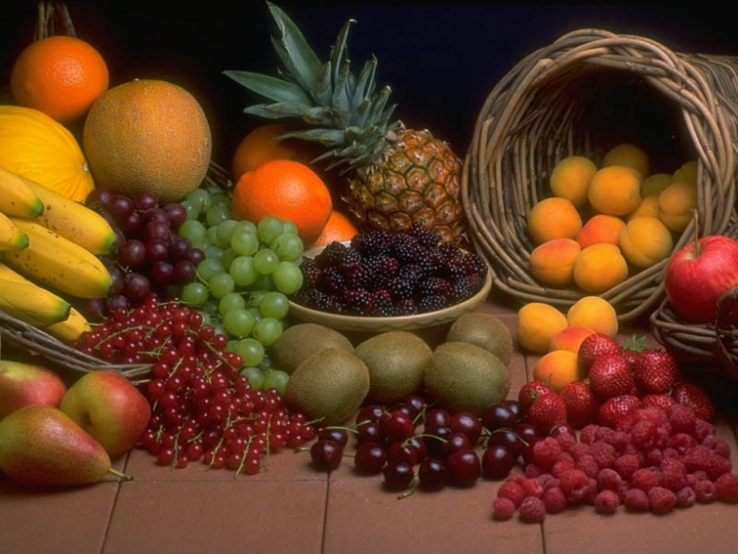
What is the fruit of our worship?
Obedience
Worship propels us to greater obedience.
To Love and worship God means that we strive to obey His commands.
Service
Worship enables us to hear the call to service clearly so we can respond.
Worship lifts our eyes off of ourselves and compels us to love and serve God and our neighbor.

Slide 12

Celebration
What do you think celebration is?
How does celebration relate to worship? And how does it relate to the whole of life?

Slide 13
The discipline of celebration defined…
The discipline of Celebration is a way of engaging in actions that orient the spirit toward worship, praise and thanksgiving.
It is the decision to joyfully set our minds on the higher things of life and requires an act of our will.
Celebration is to take joyful, passionate pleasure in God and the radically glorious nature of His Word, world, people and purposes.
Joy is the motor that keeps everything else in our Christian walk going and without celebration to infuse the spiritual disciplines we will abandon them sooner of later!

Slide 14
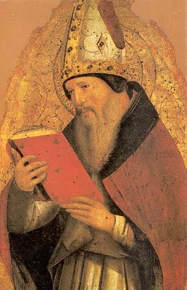
St. Augustine of hippo
“The Christian should be an alleluia from head to foot!”

Slide 15


