Slide 1


Slide 2


The Corporate disciplines: Part 1
Community & Confession

Slide 3

Community
As American’s we live in a nation that was founded on the Declaration of Independence.
And as American’s we are known for being rugged individualists.
But has this spirit of independence become a detriment to our spiritual health and well-being?

Slide 4

We live in a world that is more wired, more connected than ever, so why is it that millions of people feel more and more disconnected?
Why are people feeling so isolated, so hopeless, so alone?
May I suggest that it’s because they lack true community and satiate themselves with shadows and find their significance not in the Savior but in the idols of their own hearts.

Slide 5
Created for community
Man was created in the image of the God, and just as the God-head lives in community within itself, human beings are meant to live in connected relationships with others that reflect the glory of their creator.
This is true of humanity in general, but even more so when we speak of Christ’s body, the Church.
Jesus taught his followers that they were to be part of the family of God and as a family they were to reflect the love of God by investing in the lives of others.
As Christians we are not to seek to live our lives independently, but rather interdependently practicing the “one another’s” of scripture.

Slide 6
The One Another's of the New testament
Love one another Jn 13:34-3 ;1 Jn 3:11, 3:23. 4:7, 4:11; 2 Jn 1:5; Rom 13:8; 1 Pet 1:22
Devoted to one another/ honor one another Rom 12:10
Live in harmony w/ one another Rom 12:16 ; 1 Pet 3:8
Accept one another Rom 15:7
Instruct one another Rom 15:14
Speak to one another Eph 5:19
Greet one another Rom 16:16; 1 Cor 16:20; 2 Cor 13:12 ;1 Pet 5:14
Serve one another Gal 5:13
Bear with one another Eph 4:2
Kind and compassionate/ forgiving one another Eph 4:32
Submit to one another Eph 5:21
Admonish one another Col 3:16
Encourage one another 1 Thess 5:11; Heb 3:13, 10:25
Spur on one another Heb 10:24
Offer hospitality to one another 1 Pet 4:9
Clothe in humility towards one another 1 Pet 5:5
Fellowship w/ one another 1 Jn 1:7

Slide 7
Living out the one another’s
What does living like this actually look like?
What is the fruit of living in community?
Why do we tend to neglect the duty and discipline of community?
What steps can you take to make community a bigger part of your life?
True Christian community only exists when believers connect with each other in authentic and loving ways that encourage growth in Christ!

Slide 8
Confession
One of the disciplines that help us to live an authentic and loving Christian life is the discipline of confession.
The fact that God calls us to confess our sins is clearly supported by Scripture but even to speak of confessing sin smacks of Roman Catholicism.
But the truth is that the discipline of confession is integral part of the Protestant faith and is a necessary part of our Christian walk.
Confession in the Protestant faith takes three distinct shapes.

Slide 9
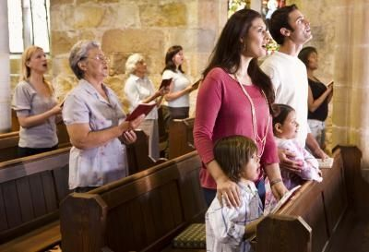
Corporate Confession of Sins
Many churches employ the reading of a prayer of confession and an assurance of pardon in their liturgy.
Through the practice of corporate confession we remind ourselves that though we have broken God’s covenant, God will hear our confession and “forgive us our sins and cleanse us from all unrighteousness” so that we might worship Him.

Slide 10
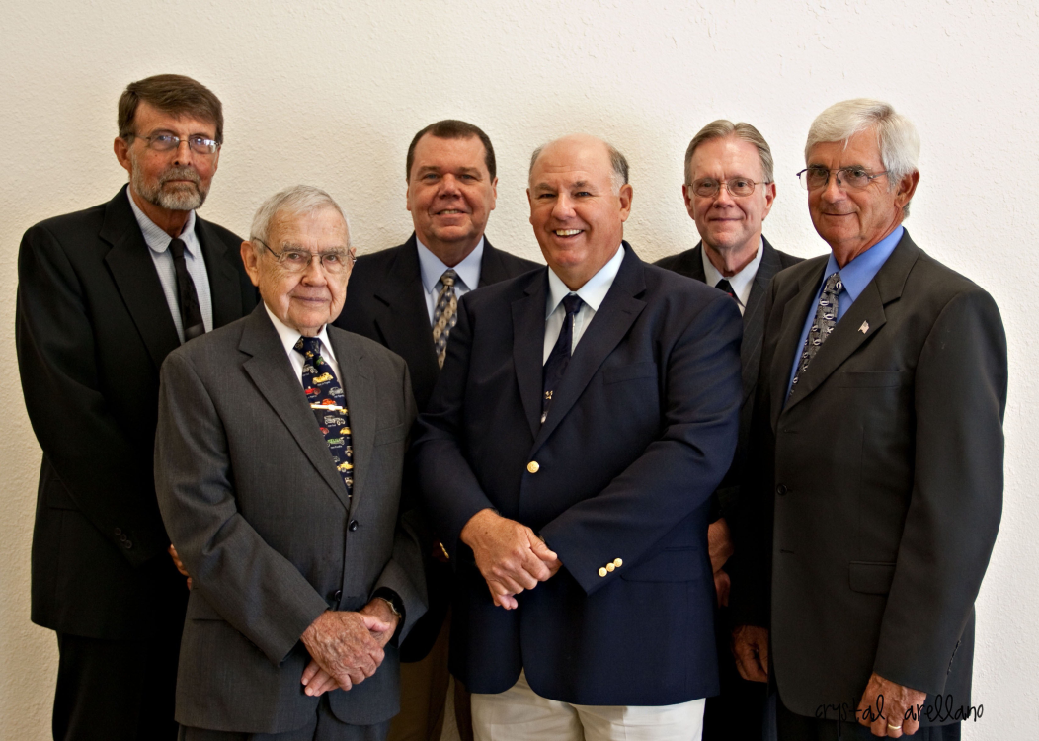
Confession by Members to their elders
God has given us elders to bear our burdens in prayer, to instruct the church where needed, and to provide accountability (Heb. 13:17).
Elders don’t forgive our sins for God, but they remind us of God’s forgiving grace, and as under-shepherds, they should always point us to our heavenly Shepherd.

Slide 11
Confession between Church members
Sin often creeps into our relationships and can destroy our unity as a body.
When this happens we may need to confess our sins and ask forgiveness from someone who our sin has affected.
Other times we may not have to confess our sins to a person we have sinned against, but it still may be helpful to confess our sins to a close friend so they can pray with us, pray for us, and help us believe in God’s assurance of forgiveness.

Slide 12
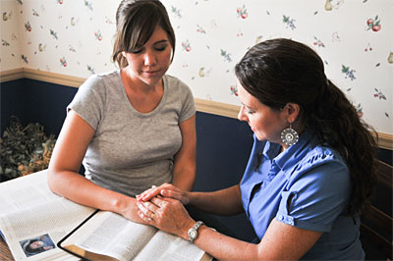
Accountability
Accountability means choosing to appropriately and reciprocally disclose struggles, failures and temptations to a godly friend who is committed to asking hard questions, willing to challenge and is given to encouragement and prayer.
James 5:16
Gal 6:1-2
Hebrews 3:13
When choosing an accountability partner you want to choose someone who is spiritually mature, wise, has common sense, is compassionate and has the ability to keep a confidence.

Slide 13

Let’s get down to brass tacks!

Slide 14
Confessing our sins to others
When is it our Christian duty to confess our sins to others?
It is our Christian duty to confess all known wrongs.
Is there a time when we are excused from confessing our sins to others?
Yes
When it is impossible.
When confession would do greater harm than good.
When the injured party would make use of the confession to ruin the confessor.

Slide 15

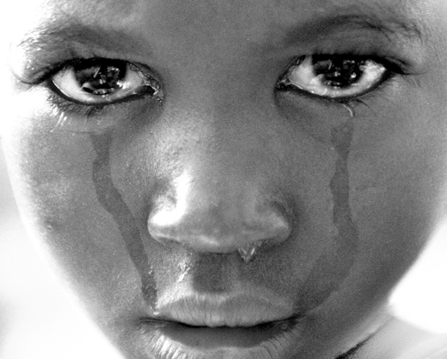

To make a good confession…
There are 3 things that are necessary:
An examination of the conscience.
Sorrow for sin.
A determination to avoid future sin.

Slide 16
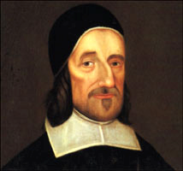
Directions about Confessing Sin to others
Prevention is the easiest way to avoid the need for confession.
Weigh the consequences of your confession before confessing to others.
Be true to your conscience and don’t willfully put off your duty to confess.
Let your repentance be deep and absolute and free from hypocrisy.
Don’t let pride stop you from humbling yourself in confession.
Richard Baxter

Slide 17
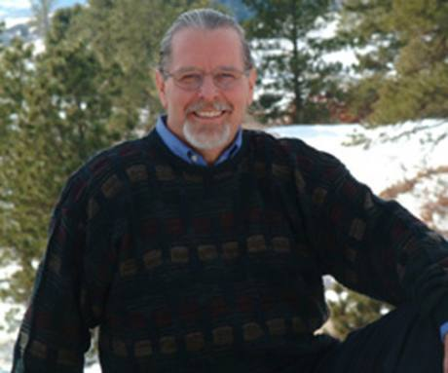
Richard Foster
“The Discipline of confession brings an end to pretense. God is calling into being a Church that can openly confess its frail humanity and know the forgiving and empowering graces of Christ. Honesty leads to confession and confession leads to change. May God give grace to the Church once again to recover the Discipline of Confession"

Slide 18


