Slide 1


Slide 2
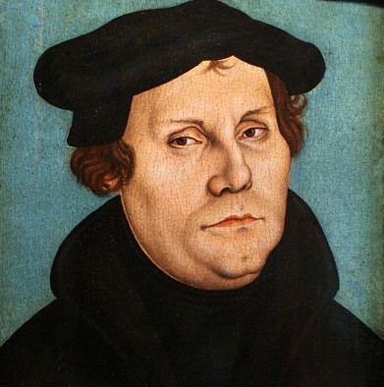
Martin Luther
“A Christian is a perfectly free lord of all, subject to none. A Christian is a perfectly dutiful servant of all, subject to all.”

Slide 3

The outward disciplines: Part 3
Submission, Service & Evangelism

Slide 4


Submission
• Submission is an unpopular, repugnant concept these days.
•The notion of giving away our power conjures images of becoming a doormat, or a brain washed cult follower.
But this perception is miles away from the biblical model of submission.

Slide 5
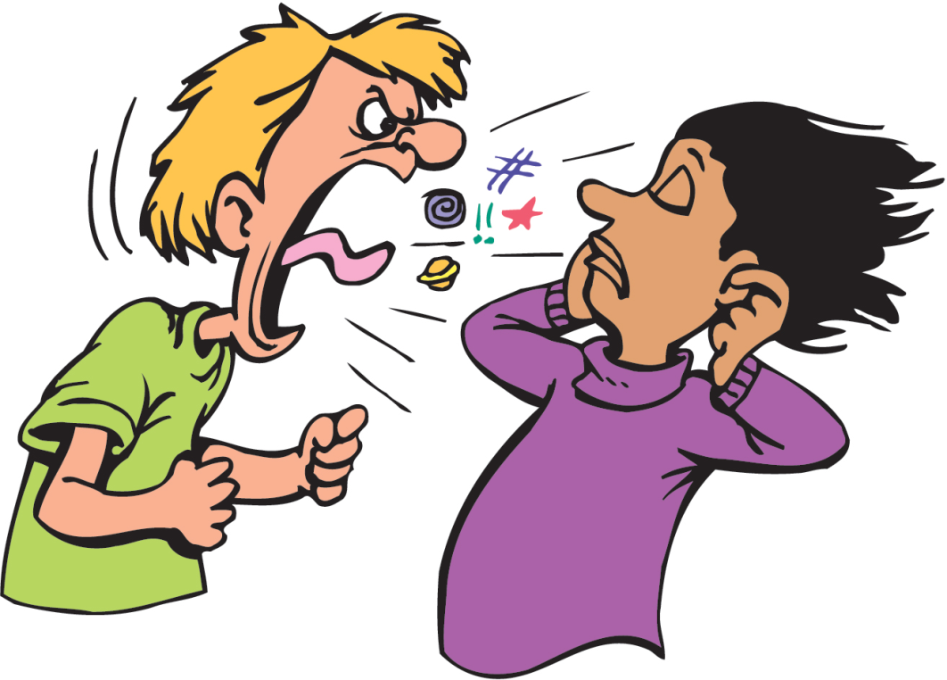
Biblical submission does not trap people in abusive relationships that rob them of their freedom.
Rather, submission is a way we allow God’s Kingdom agenda to shape our choices, relationships and vocations.

Slide 6

Biblical Submission defined
Aligning our will with God’s will and submitting to each other out of love and reverence for Christ.
It is a desire to have Jesus as Master of our lives in absolutely every way.

Slide 7

7 Acts of Submission
Submission to the Triune God.
Submission to the Scriptures.
Submission to our families.
Submission to the believing community.
Submission to our neighbors.
Submission to the broken and despised.
Submission to the world.

Slide 8
Service
Submission and service function concurrently and naturally lead one into the other.
More than any other single way, the grace of humility is worked into our lives through the discipline of service.
Service is not a list of things to do, though in it we discover things to do. It is not a code of ethics, but a way of living.

Slide 9

Service is a way of offering resources, time, treasure, influence and expertise for the care, protection, justice and nurture of others.
Service is using your gifts to build the kingdom of God.

Slide 10

Every Christian is expected to serve
But God never gives us commands to obey without reasons to follow, therefore the bible teaches us that we should be motivated to serve God and others out of…
  Obedience- Dt 13:4
  Gratitude- 1 Sam 12:24
  Gladness- Ps 100:2
  A sense of forgiveness-Isa 6:6-8
  Humility- Jn 13:12-16
  Love- Gal 5:13

Slide 11
The point is…
Just Do it!

Slide 12
Evangelism
One significant way to service others is to practice the discipline of evangelism.
"To evangelize" is to proclaim the good news.
  “For the wages of sin is death, but the free gift of God is eternal life in Christ Jesus our Lord.” Ro 6:23
Evangelism is the calling of every Christian to model and tell the difference Jesus has made in their lives.

Slide 13
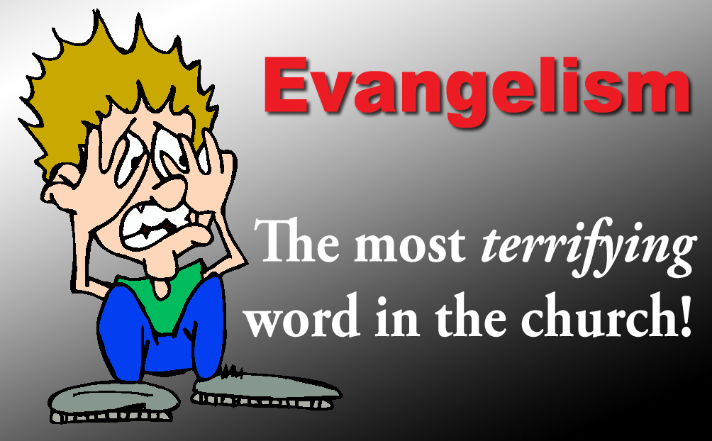
Evangelism is expected
If you are a believer this is one discipline that you are commanded to practice as part of what it mean to be a follower of Christ.
Mk 16:15
Jn 20:21
Act 1:8

Slide 14
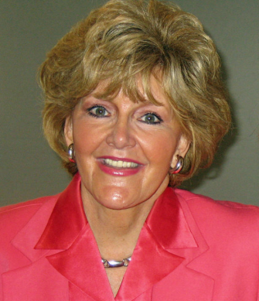
Evangelism is empowered
The power of evangelism is not specialized training but the Holy Spirit Acts 1:8
“Our communication of the gospel depends not on human strategies or well-polished techniques or even brilliantly reasoned arguments but on divine initiative. It is the hidden work of the Holy Spirit that gives our words meaning and power and that produce changed hearts.”
- Rebecca Manley Pippert

Slide 15
The most powerful ongoing Christian witness has always been the speaking of God’s word by one who is living God’s word.
So, what is success in evangelism?
    Sharing the gospel regardless of the results
But we need to remember that evangelism is a discipline, and that we must not wait for opportunities to share our faith to just happen.
Mt 5:16
Mt 28:18-20
Col 4:5-6

Slide 16
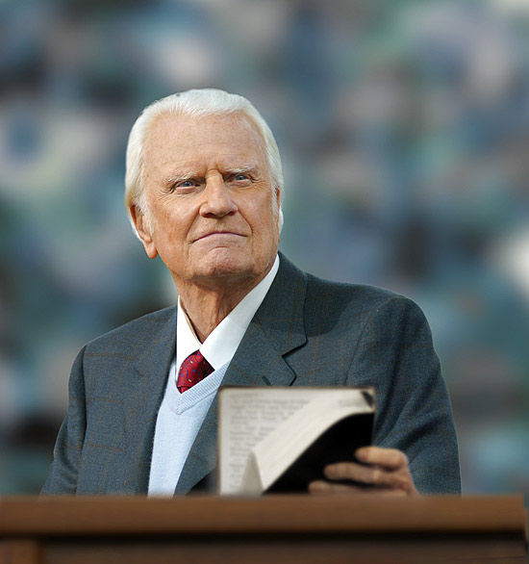
Billy Graham
“The greatest form of praise is the sound of consecrated feet seeking out the lost and helpless.”

Slide 17


