Slide 1
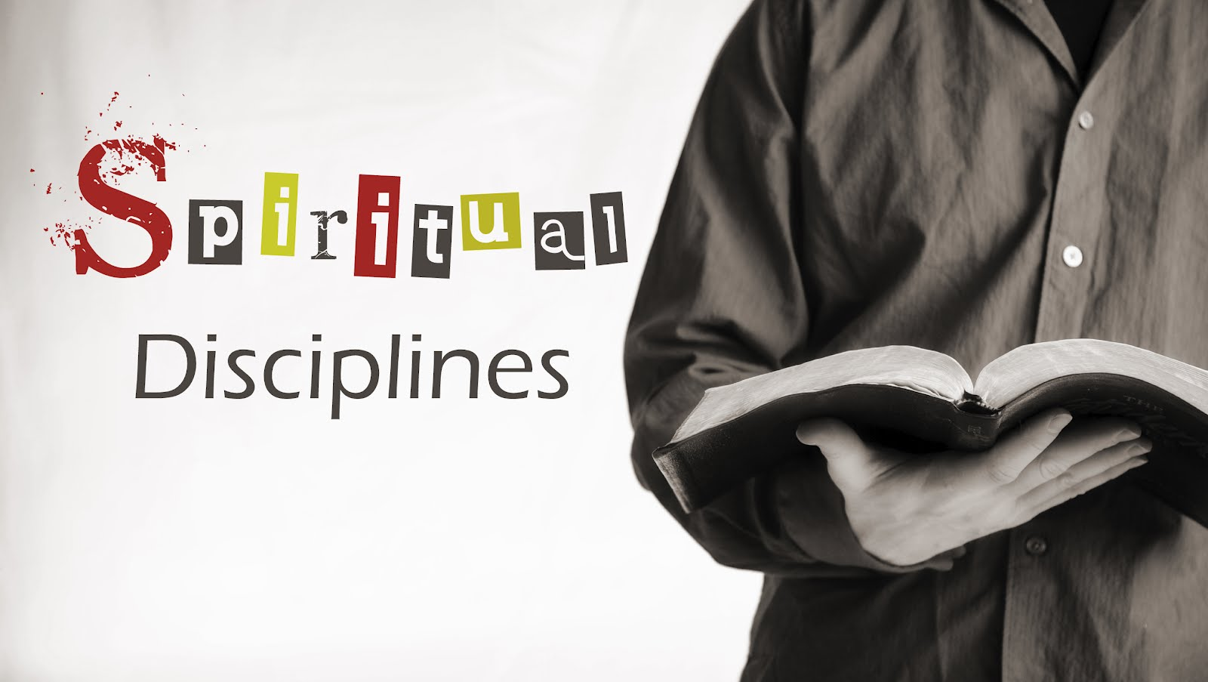

Slide 2
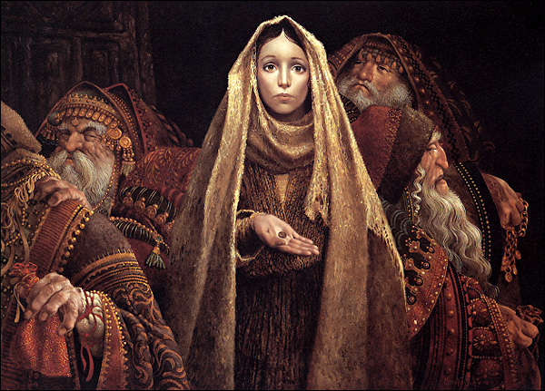
The outward disciplines: Part 2
Simplicity & Stewardship

Slide 3

Simplicity
The Spiritual Discipline of Simplicity aims at loosening inordinate attachment to owning and having.
It involves a desire to un-complicate and untangle our lives so we can focus on what really matters.
Life becomes much simpler when one thing matters most.

Slide 4
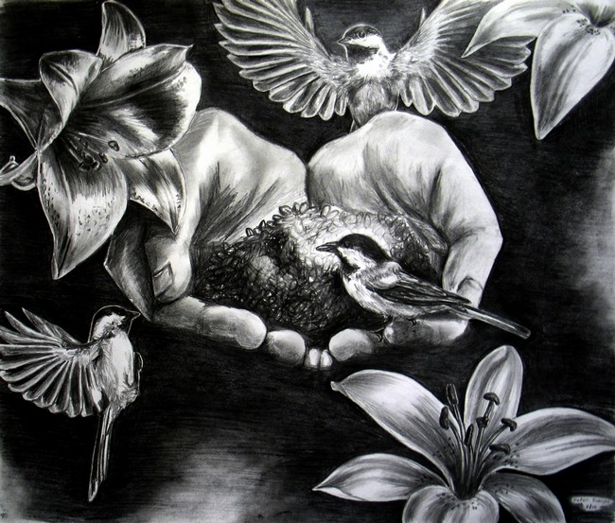
The central point of Simplicity
Mt 6:25-33*
The central point of simplicity is to seek the kingdom of God and the righteousness of His kingdom first and then everything necessary will come in its proper order.
Simplicity sets possessions in proper perspective and rejoices in God’s gracious provision.

Slide 5

Jesus wants us to know…
We don’t need the things and experiences we think we do!
Simplicity calls for a life of joyful unconcern for possessions.
Simplicity is the only thing that sufficiently reorients our lives so that possessions can be genuinely enjoyed without destroying our souls.

Slide 6
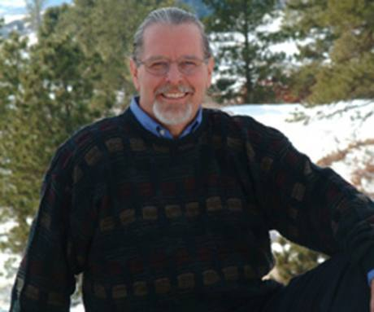
Richard Foster
“The person who does not seek the kingdom first doesn’t seek it at all.”

Slide 7
Because we often lack a divine center in our lives our need for security can lead us to an attachment to things and the discipline of simplicity cultivates the great art of letting go.
Simplicity is the inward reality of preeminent love for God and his kingdom that results in an outward life-style of putting the kingdom of God first.
An outward simplicity without the inward reality leads to deadly legalism.
True biblical simplicity is best represented in two passages
Mt 6:19-21* & Phil 4:12*

Slide 8
Question
Does practicing the discipline of Simplicity mean we can’t have and enjoy things or experiences? Why or why not?
Then what does it mean?
Once we recognize that the Bible denounces the materialist and the ascetic with equal vigor, we are prepared to understand the Christian view of Simplicity.

Slide 9
Outward expressions of inward simplicity
Avoid anything that distracts you from seeking first the Kingdom of God.
Assess things and activities and prioritize according to Kingdom principals.
Remove distractions and preoccupations with things.
Buy things for their usefulness and not status.
Reject anything that produces addiction.
Understanding that the abuse of something does not negate its proper use.

Slide 10
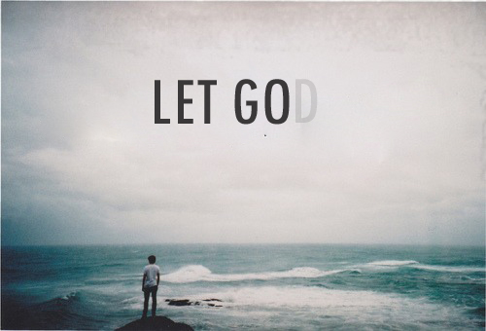
Learn to enjoy things without owning them.
Develop a deeper appreciation for creation
Look at things with a healthy skepticism.
Practice good stewardship.

Slide 11

Stewardship
Part of what it means to truly practice simplicity is stewardship
Stewardship is the voluntary and generous offering of God’s gifts of resources, time, talents and treasure for the benefit and love of God and others.

Slide 12

1st step to good stewardship
Recognize nothing belongs to us…and everything belongs to God.
Dt 10:14
Ps 24:1
Job 41:11
2 Cor 9:6-8

Slide 13
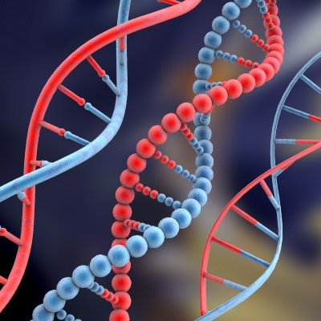
2nd step to good stewardship
Sharing needs to be in our DNA
Stewardships asks us…
What do we need to be content?
Are we willing to share?
Will we live on less so others might have more.
Are we doing all God would have us do with what He gave us?

Slide 14

3rd step to good stewardship
Discipline
Disciplined use of time
Godliness is the result of a disciplined spiritual life, but at the heart of a disciplined spiritual life is the discipline of time.
We need to use our time wisely
Time can not be regained
We are accountable to God for our time

Slide 15


Disciplined use of money
Saving (Pr. 6; 13; 21)
Giving
Is an act of worship (Phil 4:18)
Reflects faith in God’s provision (Mk 12:41-44)
Should be sacrificial and generous (Mk 12)
Reflects spiritual trustworthiness ( Lk 16:10ff)
Is love not legalism (2 Cor 9:7)
Results in blessing (Lk 6:38; 2 Cor 9:6ff; Acts 20)

Slide 16
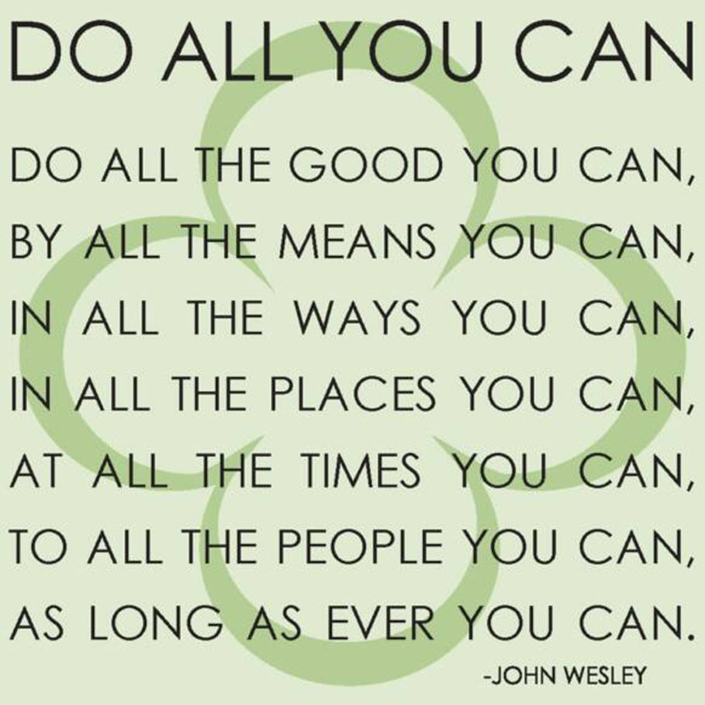
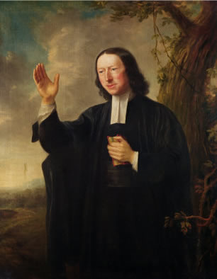

Slide 17


