Slide 1

Come in and & find a seat by yourself.
Please do not talk to anyone…sit in absolute silence until I begin the lesson.
Take this time to quiet your heart before the Lord.

Slide 2


Slide 3
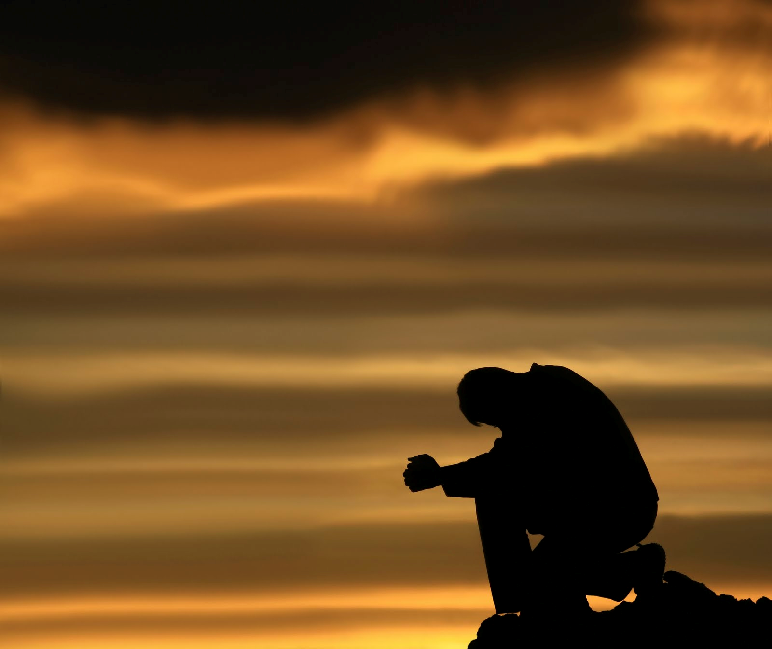
The outward disciplines: Part 1
Silence & Solitude

Slide 4
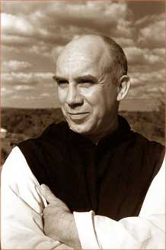
Thomas Merton
“It is in deep solitude that I find gentleness with which I can truly love my brothers. The more solitary I am the more affection I have for them… Solitude and silence teach me to love my brothers for what they are, not for what they say.”- Thomas Merton

Slide 5
Why are silence & solitude outward disciplines?
Because as creatures created in the image of the triune God we are created for community and fellowship both with God and our fellow Man.
The purpose of practicing these disciplines is to see and hear God more clearly. Therefore, we voluntarily remove ourselves from our normal interactions or abstain from speaking to others in order to focus on our relationship with God (which has both inward and outward aspects).
When we practice silence & solitude its important to see them as complementary disciplines to fellowship. Because without silence and solitude we can become shallow and without fellowship we can become stagnant.

Slide 6
As a whole we have become conditioned so that silence and solitude seem uncomfortable to us.
One reason we can hardly bear to remain silent is that it makes us feel helpless. We are so accustomed to relying upon words to manage and control others, and how we are perceived by others that we are terrified to give up that control and seek spiritual stillness.
Tell me about your experience of silence this morning. How did you feel? What were you thinking about? Were you able to find stillness?
“Real silence, real stillness, really holding one’s tongue comes only as the sober consequence of spiritual stillness.” –Dietrich Bonheoffer

Slide 7
The Discipline of Silence
The discipline of silence- is the voluntary abstention from speaking so that certain spiritual goals might be sought.
Two types of silence
Outward- not talking to anyone, but still having an internal dialogue.
Inward- active listening so that God’s voice may be heard more clearly.
Silence offers a way of paying attention to the Holy Spirit and what he brings to the surface of our souls that we need to work on.
As we remain in silence, our inner noise and chaos will begin to settle and our capacity to open up wider to God grows as he accesses places we didn’t even know existed.

Slide 8

Susan Muto with Epiphany Association
“In a noise-polluted world, it is even difficult to hear ourselves think let alone try to be still and know God. Yet it seems essential for our spiritual life to seek some silence, no matter how busy we may be. Silence is not to be shunned as empty space, but to be befriended as fertile ground for intimacy with God.”

Slide 9
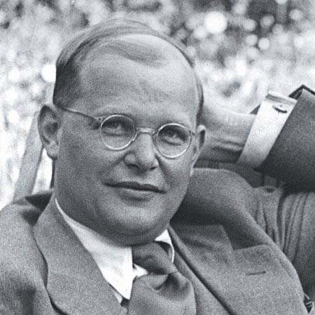
“We are so afraid of silence that we chase ourselves from one event to the next in order not to have to spend a moment alone with ourselves, in order not to have to look at ourselves in the mirror.”
–Dietrich Bonheoffer

Slide 10
The discipline of solitude
The Discipline of Solitude- is the voluntary and temporary withdrawing to privacy for spiritual purposes.
Solitude shows us who we are when productivity and recognition fall away and God is the only one watching us?
We need solitude to unmask the false self and to find our identity in Christ.
When we are able to get alone without distractions we put ourselves in a much better place for God to reveal things to us that we might not have noticed in the normal preoccupations of life.

Slide 11
9 Reasons to practice the disciplines of silence & solitude
Jesus did it- Mt 4, 14; Mk 1; Lk 4
They enable us to hear the voice of God better/ less distracted
They help us express worship to God- Habk 2:20, Zeph 1:7
There are times to speak to God and there are time simply to behold and adore him in silence. (Eccles 5:1b-2*)

Slide 12
They help us express faith in God
Wordlessness before the Lord with an absence of anxiety communicates trust in his sovereign control
They help us to seek salvation from sin & guilt- Lam 3:25-28*
They help us find physical and spiritual restoration- Mk 6:31
They help us regain a spiritual perspective- Lk 1 (Zechariah)
There is no better way to step back and get a more balanced, less worldly perspective than through the disciplines of silence and solitude

Slide 13
They help us seek the will of God- Lk 6:12-13
They help us control our tongue
The tongue is our most powerful weapon of manipulation.
“It is a restless evil, full of deadly poison.” Jas 3:7b
The tongue is a spiritual gage
thermometer- it gives us our spiritual temperature (Jas 3:9-12*)
thermostat- it regulates our spiritual temperature (Mt15:11,18-20a*)
Practicing the disciplines of silence and solitude force us to work on our heart and come before the transforming presence of God.

Slide 14
Suggested application/ Practices
Make use of “little solitudes”- take advantage of quiet moments throughout the day.
Morning cup of coffee
While driving
Take a long walk
Etc.
Make these disciplines a daily goal
Find or develop a quiet place and have regular quiet times there.
Schedule a personal retreat (overnight or weekend)

Slide 15

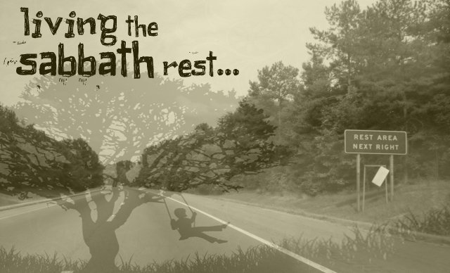

Discipline yourself so that your words are few and full
Try to live an entire day controlling you tongue- only saying edifying things.
Try to live an entire day without any words at all.
Utilize the Sabbath

Slide 16
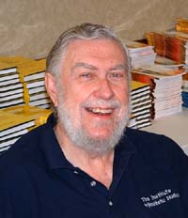
Jay Adams
The word discipline has disappeared from our minds, our mouths, our pulpits and our culture. We hardly know what discipline means in modern American society. And yet there is no other way to attain godliness; discipline is the path to godliness.”
Brothers & Sisters…if your want to be godly then let me encourage you to practice the disciplines of silence and solitude!

Slide 17


