Slide 1
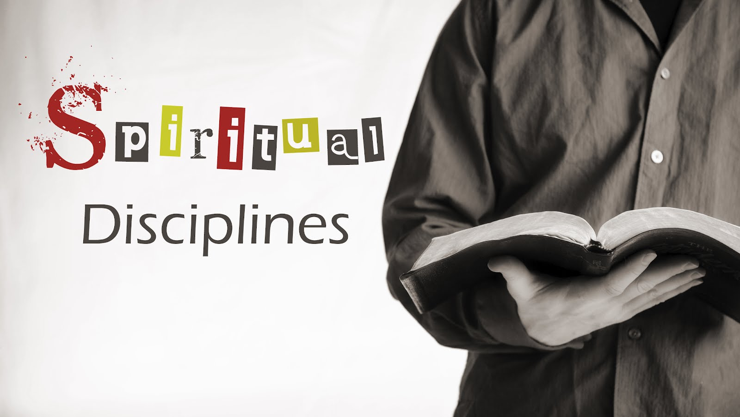

Slide 2
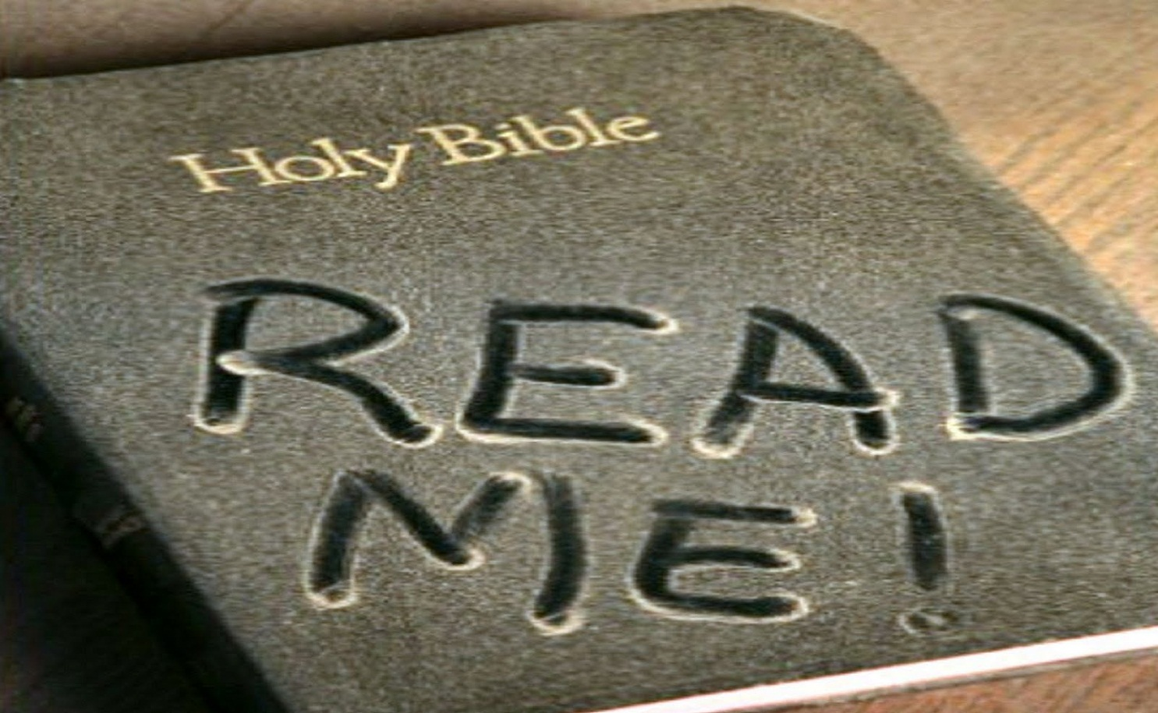
The inward disciplines: Part 2
Bible Intake & Journaling

Slide 3
Bible Intake
Encompasses everything we are going to be talking about today.
Reading God’s Word
Studying God’s Word
Hearing God’s Word

Slide 4
Before We begin…
No spiritual discipline is more important than the intake of God’s Word, nothing can substitute for it!
Ignorance of Scripture is ignorance of Christ.
—Jerome, A.D. 340-420

Slide 5
Hearing God’s Word
The easiest of the disciplines related to the intake of God’s Word is simply hearing it.
Why is this considered a discipline?
Because it takes a certain amount of dedication or discipline to intentionally position ourselves to hear God’s Word spoken to us.
Also hearing God’s Word is not merely a passive listening, but rather an active discipline that is to be cultivated. You should be engaging your mind and not simply letting the words wash over you!
For most of us Hearing God’s Word means developing a practice of attending church and hearing God’s Word faithfully preached.
But there are other ways of hear God’s Word, such as, radio, TV, CDs and the internet.

Slide 6
Reading God’s Word
A survey done by the Barna Research Group determined that 1 in 4 (25%) professing Christians say they never read the Word of God.
If “man does not live on bread alone, but on every word that comes from the mouth of God” (Mt 4:4) than surely those who profess to be the people of God are expected to read scripture?
2 Tim 3:16*; Rev 1:3*
Shouldn’t we read it????
What I have in mind here is Devotional Reading.
This type of reading is aimed more at growing a relationship with God than gathering information about God.

Slide 7
Devotional Reading
Traditionally Devotional Reading is made up of 5 parts…
Silencio- Quiet preparation of the heart.
Lectio- Reading of the passage slowly aloud letting the words resonate in your heart. Listen to what God is saying to you.
Meditatio- Meditate. Read the passage again and reflect on the importance of the words.
Oratio- Respond, pray. Read the passage a third time. Talk to God about the passage and how it makes you feel.
Contemplatio- Contemplate. Rest and wait in God’s presence. Allow time for the word to sink in to your soul and surrender yourself to God.

Slide 8
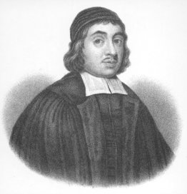
An aside on meditation
“The reason we come away cold from reading the Word is, because we do not warm ourselves at the fire of meditation.”
-Thomas Watson
Puritan theologian & pastor

Slide 9
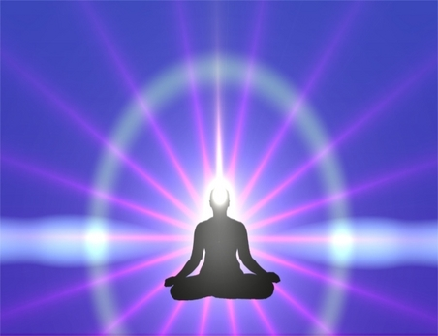
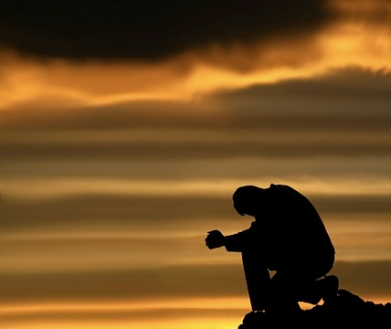
Eastern Meditation Vs. Biblical Meditation
Eastern Meditation
Biblical Meditation
You empty your mind, you think nothing and allow yourself to simply be, to just exist.
Filling your mind with Truth and giving your undivided attention to God.

Slide 10

Biblical Meditation is like a cup of Tea…

Slide 11
Suggested Practices…
Pick an appropriate passage
Repeat it aloud in different ways.
Rewrite the passage in your own words.
Look for application of the text.
Pray through the text
Attempt to memorize the text
Don’t rush- take your time.
Focus on developing a familiar friendship with Jesus (Thomas a Kempis).
Obey His Word.
Remember that true contemplation is not a psychological trick but a theological grace (Thomas Merton).

Slide 12
Studying God’s Word
Meditation is devotional, study is analytical. Meditation will relish a word; study will explicate it.
Reading gives us breath, but study give us depth. (Jerry Bridges)
Bible study involves engaging the mind and focusing on Scripture in an attempt to understand and apply truth to every part of life.
For our purposes here I will give you a quick overview and I have included a more detailed procedure in your packet of handouts.

Slide 13
4 steps to Studying God’s Word
Repetition- develop a habit of study and study passages multiple times
Concentration- center your mind and give full attention on what is being studied.
Comprehension- focus on understanding the meaning of the passage and on the knowledge of the truth.
Reflection- determine why this passage is significant and seek to apply its truth to your life.

Slide 14
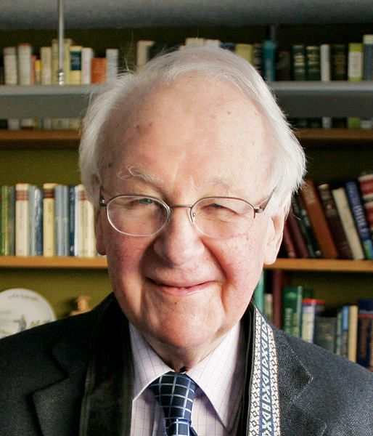
John Stott
“In the Bible God gives us revelations of himself which lead us to worship, promises of salvation which stimulate our faith, and commandments expressing his will which demand our obedience. This is the meaning of Christian discipleship.”

Slide 15
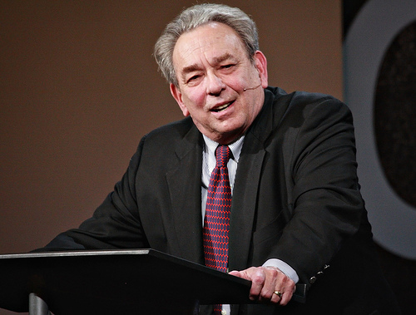
If this is true than why do so many Christians neglect the study of God’s word?
“ Here then, is the real problem of our negligence. We fail in our duty to study God’s Word not so much because it is difficult to understand, not so much because it is dull and boring, but because it is work. Our problem is not lack of intelligence or lack of passion. Our problem is that we are lazy.”
- RC Sproul

Slide 16

Another reason…
Insecurity about how to study the Bible or even where to begin????

Slide 17
Journaling
Journaling is a tool for reflecting on God’s presence, guidance and nurture in daily living and is the place to record all of your spontaneous devotional thoughts or theological musings.
Journals can be a profitable way to record all the fruit of your Bible Intake and journals can be a valuable aid in…
Understanding and evaluating yourself.
Meditation.
Expressing thoughts and feelings to the Lord.
Remembering the Lord’s work
Monitoring goals and priorities
Preserving a spiritual heritage

Slide 18

Questions???

