Slide 1


Slide 2

The inward disciplines: Part 1

Slide 3
DA Carson: What is Prayer?
http://www.youtube.com/watch?v=muiwzkFO-k0

Slide 4
What is Prayer?
WSC 98 “Prayer is an offering up of our desires unto God, for things agreeable to his will, in the name of Christ, with confession of our sins, and thankful acknowledgment of his mercies.”
WLC 178 “Prayer is an offering up of our desires unto God, in the name of Christ, by the help of his Spirit; with confession of our sins, and thankful acknowledgment of his mercies.”
Prayer is… “a privilege and an obligation of the Christian where we communicate with God. It is how we convey our confession (1 John 1:9), requests (1 Tim. 2:1-3), intercessions (James 5:15), thanksgiving (Phil. 4:6), etc., to our holy God.”

Slide 5

Why is prayer so important?

Slide 6
To pray is to change
Prayer is one of the means of grace that God uses to transform us.
In prayer, real prayer, we begin to think God’s thoughts after him: to desire the things he desires, to love the things he loves, to will the things he wills and progressively we are taught to see things from his point of view.
Rather than beating ourselves up for our obvious lack of prayerfulness, we should remember that God always meets us where we are and slowly moves us along into deeper things.

Slide 7
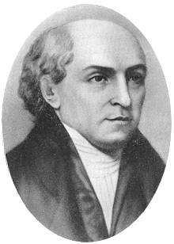
William Carey “the father of modern missions”
“Prayer-secrete, fervent, believing prayer-lies at the root of all personal godliness.”

Slide 8
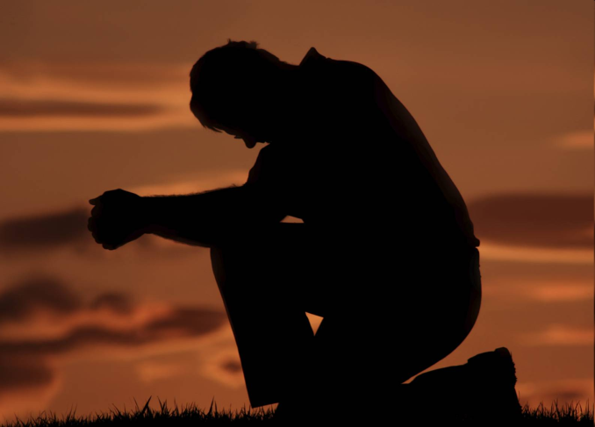
Prayer is expected
Jesus Expected It
God’s Word Expects it
Mt 6:5-7
Lk 18:1
Col 4:2
1 Thes 5:17

Slide 9
If prayer is expected than…
Why, do so many believers confess that they don’t pray as they should?
Lack of discipline
Time management
We doubt anything will actually happen
Lack of sensing God’s nearness
Lack of awareness
A spirit of self-sufficiency
They haven’t learned how

Slide 10
Prayer is something we learn
So how do we learn to pray?
By actually praying
We need to practice- ex. learning a foreign language
The beginning point in learning to pray is to listen for guidance.
The Holy Spirit teaches praying people how to pray better- (Jn 16:13)
Be open, honest and trust the Lord with all of your thoughts and feelings.

Slide 11


2. By meditating on scripture
3. Read about prayer

Slide 12

Tell us about your experience of prayer
What works for you that might be helpful to others?

Slide 13

An overview of: Fasting
Some have exalted religious fasting beyond all Scripture and reason; and others have utterly disregarded it.
-John Wesley

Slide 14
Throughout Scripture fasting refers abstaining from food for spiritual purposes.
Types:
Normal-abstain from all food but not water
Partial-limitation on diet i.e. only veggies (Dan)
Absolute- no food or water
Supernatural -40 days/nights no food or water (Dt 9:9)
Private
Congregational
National
Occasional-special occasion/ as needed

Slide 15
The purposes of fasting
Strengthen prayer (Ezra 8)
Seek God’s guidance (judges 20)
Express grief (1 Sam 31)
Seek Deliverance or protection (2 Chron 20)
Express repentance & return to God (Jonah 3)
To humble oneself before God (Ps 35)
To express concern for the work of God ( Dan 9)
To overcome temptation and to dedicate yourself to God ( Mt 4)
To express love & worship to God.( Lk 2)

Slide 16
Steven Chin Senior Pastor of Boston Chinese Church
http://www.youtube.com/watch?v=rP-q0w2AqCA

Slide 17
The practice of fasting
Though not explicitly commanded fasting seems expected
Mt 6:16 “And when you fast…”
Mt 9 “and then they will fast.”
So when you begin to practice the discipline of fasting…
Begin with a partial fast
After 2-3 weeks move to normal fast
Then extend time and days

Slide 18


Alternative Fasts
Media fast
Sexual Abstinence
1 Cor 7:5

Slide 19

Question & Answer

