Slide 1


Slide 2
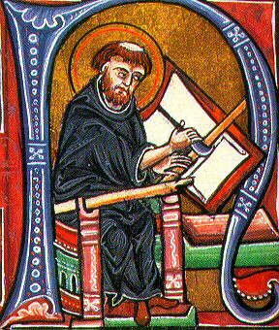
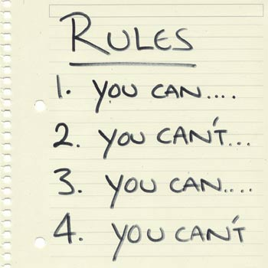
What do you think of when you think of Spiritual disciplines?

Slide 3

Lay a foundation for understanding Spiritual disicplines upon…

Slide 4

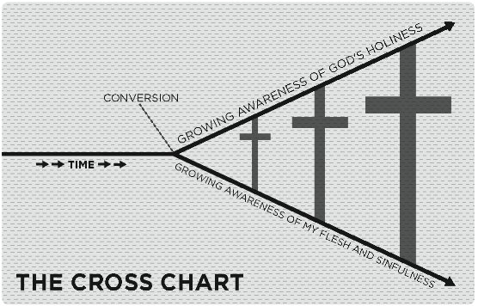

Slide 5
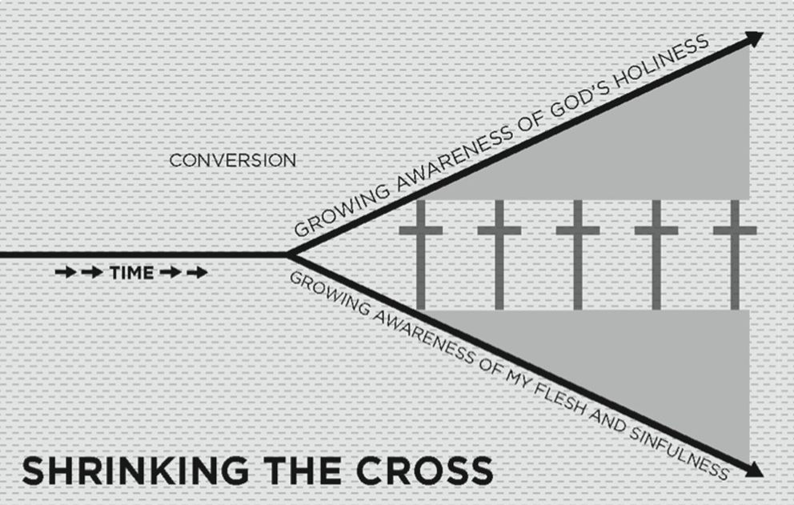
Pretending & performing

Slide 6
Pretending
Because a growing awareness of sin can become a crushing weight we sometimes compensate by pretending that we are better than we really are. We spin the truth!
Dishonesty
“I’m not that bad”
Comparison
“I’m not as bad as those people”
Excuse making
“I’m not really that way”
False righteousness
“Here are all the good things I have done”

Slide 7
Performing
A growing awareness of God’s holiness is also challenging. It means realizing how dramatically we fall short of His standards and reflecting on His holy displeasure towards sin.
Sometimes we try to compensate by trying to earn God’s approval through our performance.
This disconnects us from the power of the gospel and finding our righteousness in anything but the finished work of Christ leads us into more sin, not less.

Slide 8
License & Legalism
When it comes to holiness and the Christian life pretending and preforming lead to two traps: License & Legalism. Neither are pleasing to God and both are sin.
License- being apt to justify sin by pulling the “grace card.” Grace becomes license to live in the flesh and silence the conscience (i.e. I’m saved by grace so can do whatever I want).
Legalism- is an improper fixation on a code of conduct and the belief that obedience to the law or a set of rules is the pre-eminent principle of redemption and favor with God (i.e. God’s acceptance and our sanctification comes from trying hard to be a “good Christian”).

Slide 9
Research by the Barna Group in partnership with Living on the Edge shows that 81% of self-identifying Christians endorsed the statement that spiritual maturity means “trying hard to follow the rules described in the Bible.”
4 out of 5 Born Again Christians concurred.
However the truth is that we are called to reject both license and legalism and to believe the gospel.
We don’t need to do anything to secure God’s love and acceptance; Jesus has secured it for us. The good news of the gospel is not that God favors us because of who we are, but that he favors us in spite of who we are.

Slide 10

Randy Alcorn

Slide 11
When it come to spiritual disciplines…
License says, “I don’t have to do that stuff.”
Legalism says, “I better do that stuff and so should you!”
We want to be careful not to fall into either of these traps, but rather we want to view spiritual discipline through the gospel grid and pursue holiness in the power of the Spirit by grace.
We need to see spiritual disciplines as practices that we willingly pursue in response to a God who created us, saved us, and guides us.
Spiritual disciplines draw us closer to God, deepen our understanding of who He is, and help make us into the men and women He desires us to become.

Slide 12
Spiritual disciplines are not something that we do out of guilt or obligation and they are not a way to gain God’s attention or earn our way to heaven.
Spiritual Disciplines are a means of grace that grant us liberation from the stifling slavery of self-interest and fear.
The overarching purpose of practicing spiritual disciplines is Godliness.
We ordinarily depend upon our will power and determination but God’s eternal plan ensures that every Christian will ultimately conform to the image of His Son by His grace alone.
Ro 8:29a
“For those whom he foreknew he also predestined to be conformed to the image of his Son…”

Slide 13
But we aren’t merely to wait for holiness, we are to pursue it!
Gal 6:7-9
“Do not be deceived: God is not mocked, for whatever one sows, that will he also reap. For the one who sows to his own flesh will from the flesh reap corruption, but the one who sows to the Spirit will from the Spirit reap eternal life. And let us not grow weary of doing good, for in due season we will reap, if we do not give up”
Heb 12:14
“Make every effort to live in peace with everyone and to be holy; without holiness no one will see the Lord.”
1 Tim 4:7b
“…train yourself for godliness.”
Prov 23:12
“Apply your heart to instruction and your ear to words of knowledge”

Slide 14
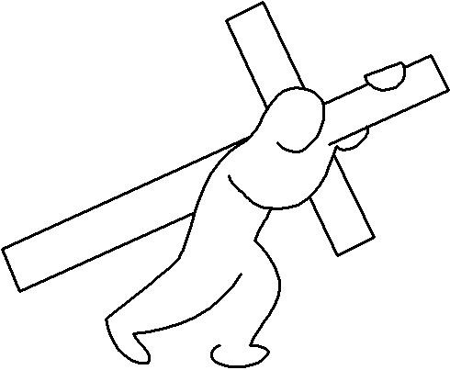
Luke 9:23
And he said to all, “If anyone would come after me, let him deny himself and take up his cross daily and follow me.

Slide 15
God intends the disciplines of the spiritual life to be for ordinary human beings: people who have jobs, care for children, who wash dishes and mow lawns.
But many professing Christians are so spiritually undisciplined that they seem to have little fruit and power in their lives.
There are many Christians who are faithful church attenders, who demonstrate genuine enthusiasm for the things of God, and who dearly love the Word of God and trivialize their effectiveness for the Kingdom through lack of discipline.
Though we all fall short and occasionally go through seasons of laziness, license and legalism when we remember that the goal of the disciplines is Godliness the spiritual disciplines become a delight instead of drudgery and we experience growth and victory in the Lord.

Slide 16
2 Peter 1:3-11 reminds us…
His divine power has granted to us all things that pertain to life and godliness, through the knowledge of him who called us to his own glory and excellence, which he has granted to us his precious and very great promises, so that through them you may become partakers of the divine nature, having escaped from the corruption that is in the world because of sinful desire. For this very reason, make every effort to supplement your faith with virtue, and virtue with knowledge, and knowledge with self-control, and self-control with steadfastness, and steadfastness with godliness and godliness with brotherly affection, and brotherly affection with love…

Slide 17
For if these qualities are yours and are increasing, they keep you from being ineffective or unfruitful in the knowledge of our Lord Jesus Christ. For whoever lacks these qualities is so nearsighted that he is blind, having forgotten that he was cleansed from his former sins. Therefore, brothers, be all the more diligent to confirm your calling and election, for if you practice these qualities you will never fall. For in this way there will be richly provided for you an entrance into the eternal kingdom of our Lord and Savior Jesus Christ.

Slide 18
So with this in mind…
Over the next couple of months we will explore the spiritual disciplines of the Christian life.
Weeks 2-3 | Weeks 4-5 | Weeks 6-7 | Week 8
Inward Disciplines: Meditation, Prayer, Fasting, Study, Journaling | Outward Disciplines: Simplicity, Silence/Solitude, Submission, Service, Evangelism, Stewardship | Corporate Disciplines: Confession,Worship, Guidance, Celebration | Perseverance

Slide 19


